Slide 1

ALY 6015 - 21454 Intermediate Analytics Presidential Election Analysis
By –
Akash Raj, Harshit Gaur & Mirav Ajay Parekh
Group 8

Slide 2
Contents
Overview
Scope of Project
Exploratory Data Analysis (EDA)
Application to Analytical Methods
Results & Conclusion
Further Improvements

Slide 3
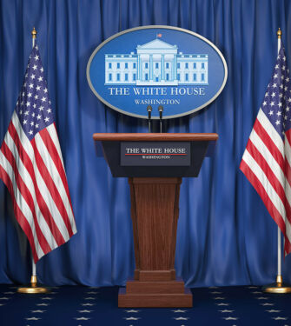
Overview
Every 4 years, the US general election is held to choose the president and the vice-president of the United States.
The 2 major political parties competing in the elections are the Democrats, and the Republicans.
In each counties, US citizens vote for their presidential choice in their respective electoral college.
Campaigns are run by the political parties in each county to gain support of people.
These campaigns are massive in the swing states of Florida, Ohio, Pennsylvania, also known as “Battleground States”.

Slide 4

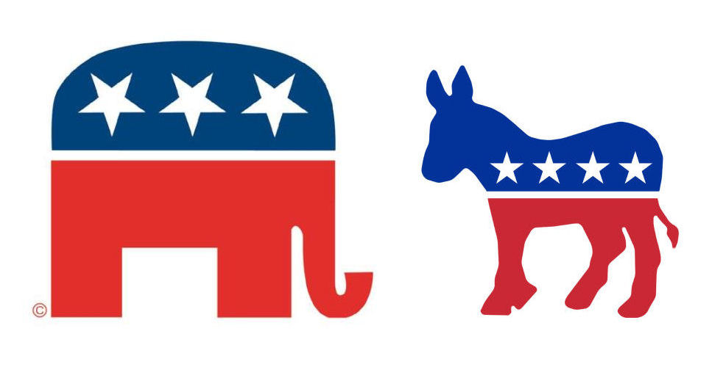
Scope of the project
What factors and attributes of a county influence the results of presidential election?
Can we predict which party will win the 2016 presidential election in each county?

Slide 5






Exploratory Data Analysis
To perform the analysis, we used county-level voter data from the presidential elections of 2008, 2012, and 2016. The data set has 3,143 observations with 148 features.
2 Categorical variables
146 Continuous variables
Population demography
Household attributes
Education and employment estimators
Poverty indicators
Criminal activities
Population migration

Slide 6
Exploratory Data Analysis
Data Cleaning
Finding Patterns
Feature Engineering
Variable Transformation
Imputed missing values in Quantitative features with their mean values.
Eliminated an almost empty feature of ‘Libertarian’
Merged additional data sets at county-level related to Population, Race, Age, Region, Gender to broaden dimensionality for our analysis.
Treatment of some character features as Factors.
Created new features from votes and its difference between the parties for winning probability in each county.
Visualized all the categorical and numeric features to identify relationships between them.

Slide 7
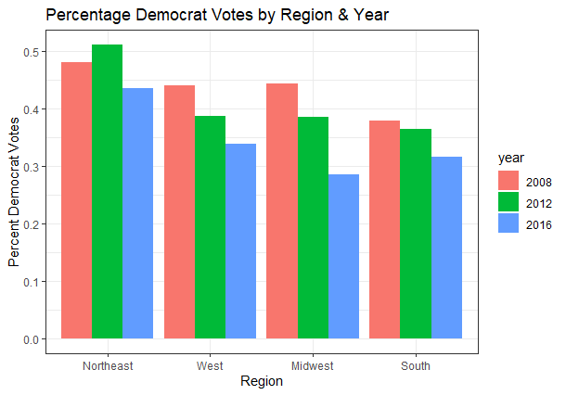
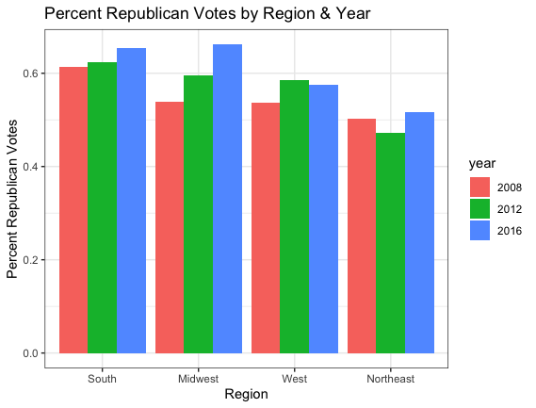
Exploratory Data Analysis
The % Democrat votes has decreased over the over the years, whereas the % Republican votes have increased

Slide 8
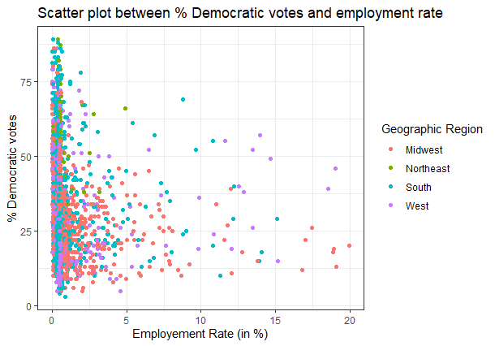
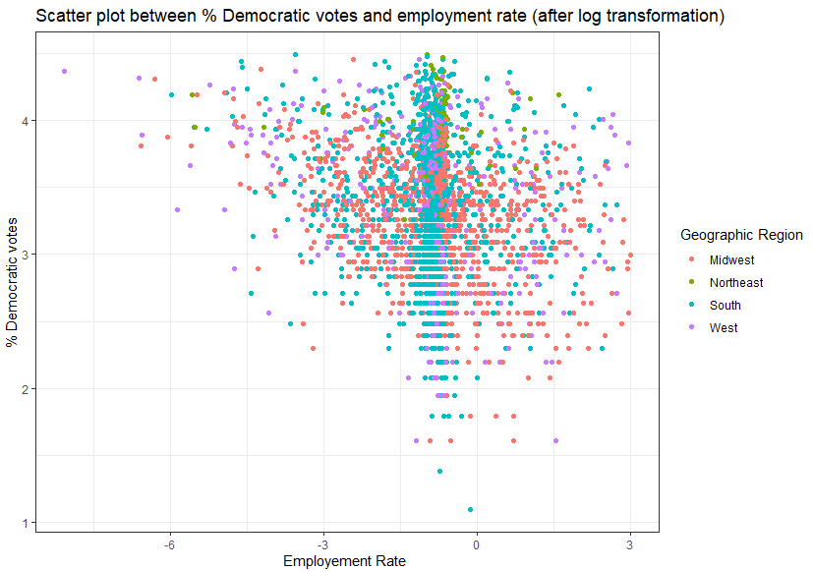
Exploratory Data Analysis
There’s no linear relationship between the dependent variable % democrats votes and employment rate; Variable transformation was performed on these variables

Slide 9



Analytical Methods
Different analytical methods were used for feature selection and building statistical models
Correlation
Study the strength of relationships between variables
Correlation
Stepwise Regression
MERCURY
Stepwise Regression
Selection of statistically significant features for predictive modeling
Lasso Regularization
Linear Regression
Lasso Regularization
Reduces model complexity and prevents over-fitting of the model
Linear Regression
Linear modeling technique of a scalar outcome variable with one or more exploratory variables

Slide 10
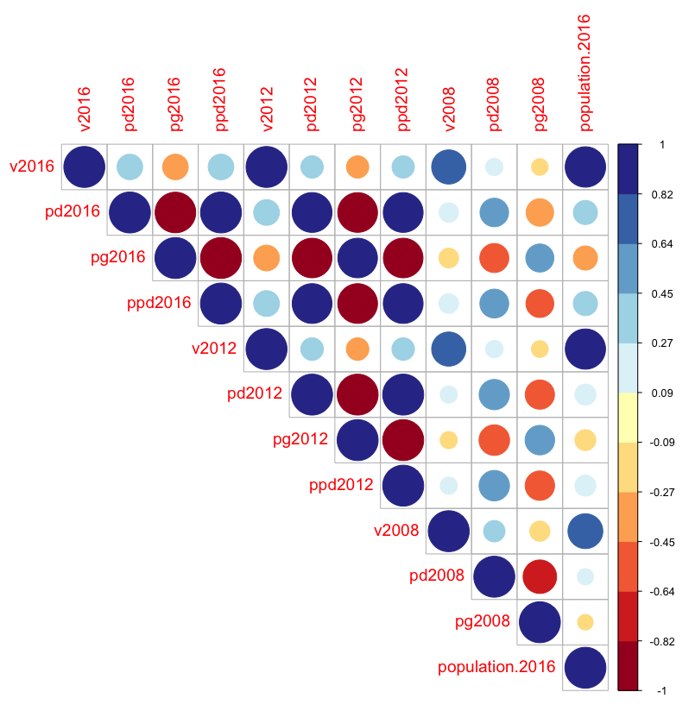



Correlation
8
Poverty estimators are highly correlated with crime rate.
6
Vote percentage is significantly correlated with population demography
9
Employment indicators are highly correlated with the household income attributes

Slide 11

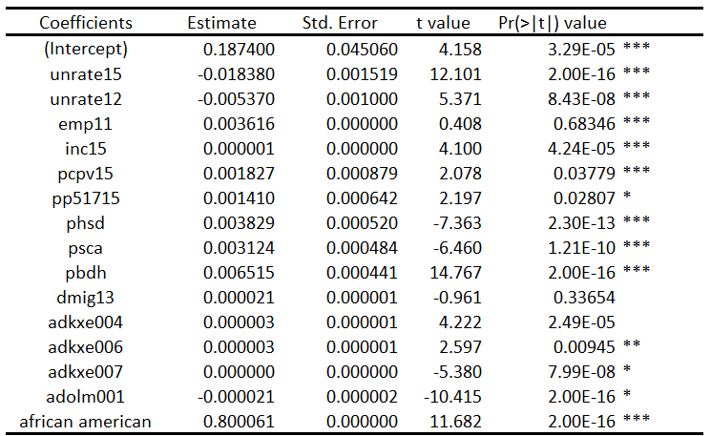

Stepwise and Linear Regression
Unemployment Rate
Race (African American, American Indian, Asian, White)
Median Household Income
Poverty Estimators
Educational Attainments (Diploma, Bachelor, Masters, PhD.)
Migration Rates
For every percentage of increase in African American population, 0.8 percent of democratic votes should increase
For every percentage of decrease in unemployment rate, 0.02 percent of democratic should increase.
For educational attainment increase in the country, around 0.05 percent increase should be in democrat votes
R-Square: 0.5851 Adjusted R-Square: 0.6038

Slide 12
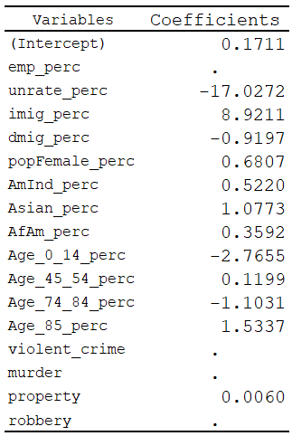
Lasso Regularization
Unemployment Rate
Race (African American, American Indian, Asian, White)
Criminal Activity Estimators
Population Demography
Migration Rates
Lasso regression penalized some features which contributed to over-fitting of the models.
Features related to crime (murder, violent crime, robbery, etc.) were deemed to over-fit and add complexity to the model.
Their coefficients were shrunk by the algorithm.
Test RMSE: 0.08 Test MAPE: 68%

Slide 13

Recommendation
What factors and attributes of a county influence the results of presidential election?
Unemployment Rate
Race (African American, American Indian, Asian, White)
Median Household Income
Poverty Estimators
Educational Attainments (Diploma, Bachelor, Masters, PhD.)
Migration Rates
Can we predict which party will win the 2016 presidential election in each county?
Accuracy of around 60% which suggests that we were able to predict the winning party of the US Presidential election in 60% of the counties correctly along with the usage of external data. For now, we can say that democrats have solid base in counties having
However, we also need more dimensionality to the analysis data to achieve more accuracy.
Citizens with High Educational Attainment
Less Crime Rate
High African American population
Less Unemployment rate

Slide 14



Further Improvements
The variables included in the model are not sufficient to explain the dependent variables. Other variables would be required to improve the model, like macro and micro economic variables, policy making, approval rating etc.
The dependent variable didn’t have linear relationship with some independent variables. Further exploration and feature engineering, like creating composite variables and variable transformation would improve the model.
The dependent variable did not have linear relationship with some independent variables. A non-linear tree-based regression model like Random Forest or Gradient Boosting might work better.

Slide 15
References
Downloadable Data – DASIL. (2017). County-Level Presidential Election Data 2008 – 2016. https://dasil.sites.grinnell.edu/downloadable-data/
Bluman, A. (2017). Elementary Statistics: A Step By Step Approach (10th ed.). McGraw-Hill Education.
Kabacoff, R., I. (2022). R in Action, Third Edition. Manning.

Slide 16


